Slide 1

Data-Intensive Computing with MapReduce
Session 3: Basic Algorithm Design
Jimmy Lin
University of Maryland
Thursday, February 7, 2013
This work is licensed under a Creative Commons Attribution-Noncommercial-Share Alike 3.0 United States See http://creativecommons.org/licenses/by-nc-sa/3.0/us/ for details

Slide 2

Source: Wikipedia (The Scream)

Slide 3

Source: Wikipedia (Japanese rock garden)

Slide 4
Today’s Agenda
“The datacenter is the computer”
Understanding the design of warehouse-sized computes
MapReduce algorithm design
How do you express everything in terms of m, r, c, p?
Toward “design patterns”

Slide 5

The datacenter is the computer!
Source: Google

Slide 6
“Big Ideas”
Scale “out”, not “up”
Limits of SMP and large shared-memory machines
Move processing to the data
Cluster have limited bandwidth
Process data sequentially, avoid random access
Seeks are expensive, disk throughput is reasonable
Seamless scalability
From the mythical man-month to the tradable machine-hour

Slide 7
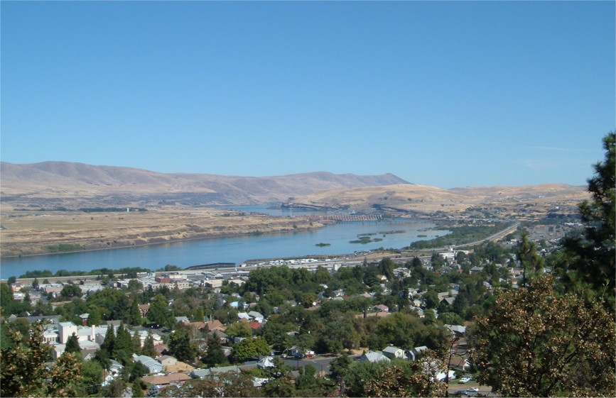
Source: Wikipedia (The Dalles, Oregon)

Slide 8
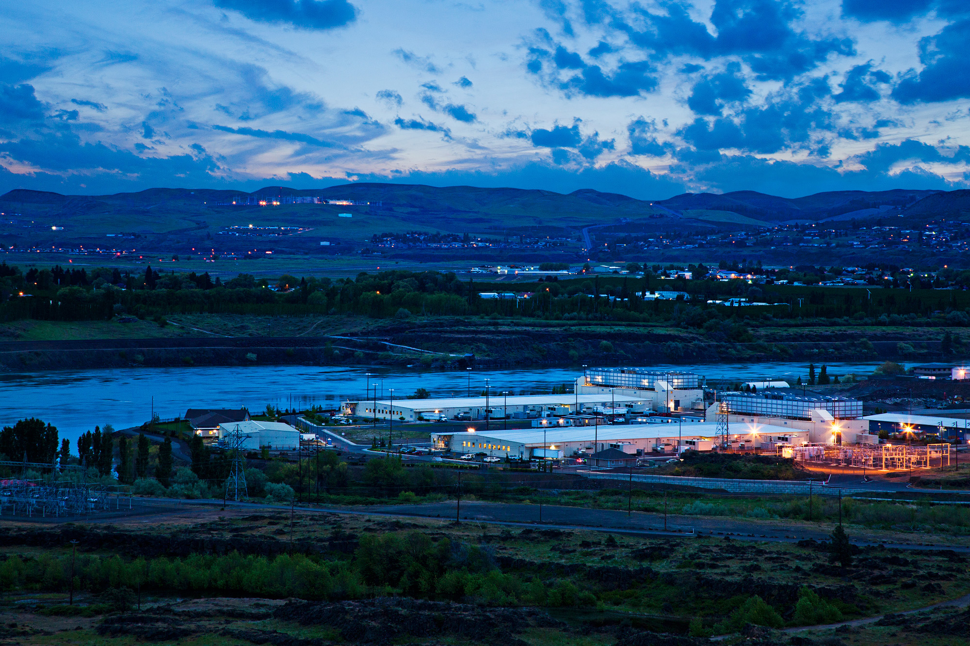
Source: Google

Slide 9

Source: Google

Slide 10
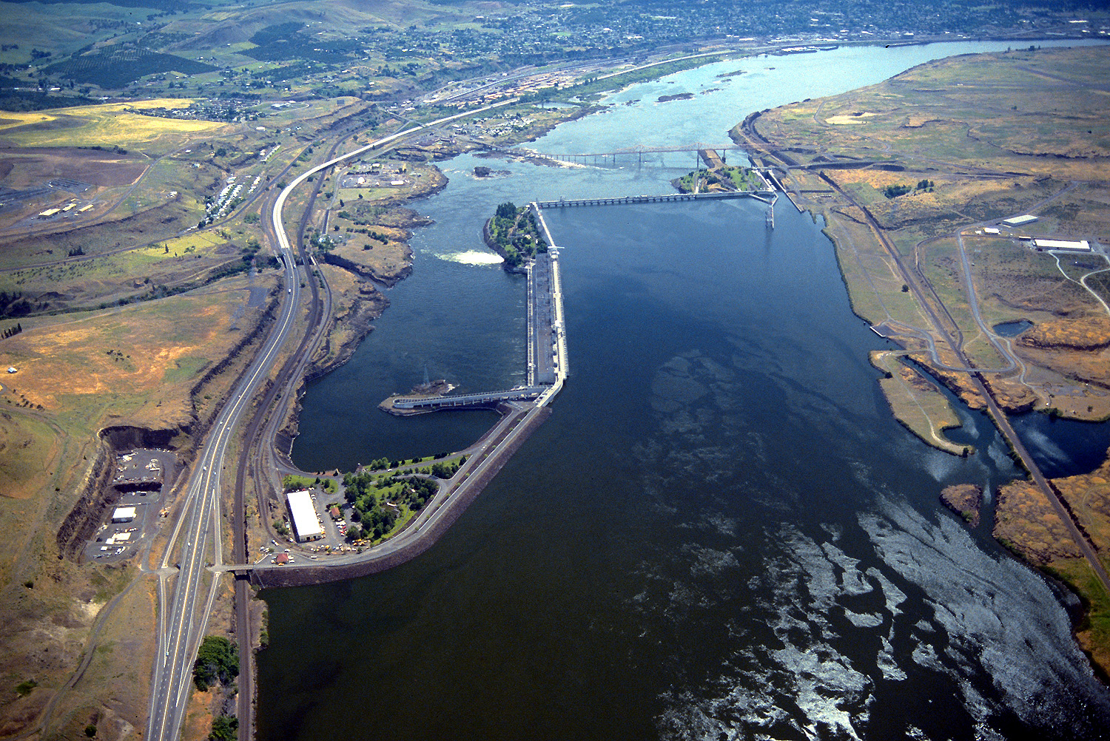
Source: Bonneville Power Administration

Slide 11
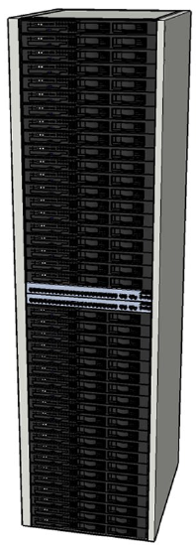
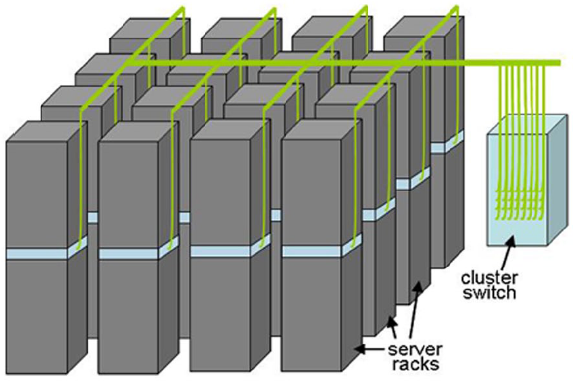

Building Blocks
Source: Barroso and Urs Hölzle (2009)

Slide 12

Source: Google

Slide 13

Source: Google

Slide 14

Source: Facebook

Slide 15
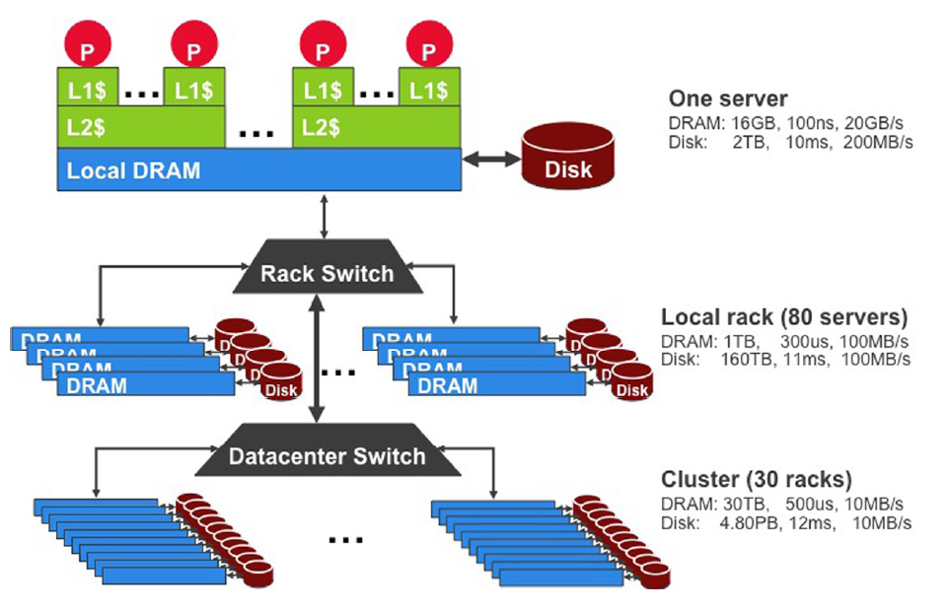
Storage Hierarchy
Funny story about sense of scale…
Source: Barroso and Urs Hölzle (2009)

Slide 16
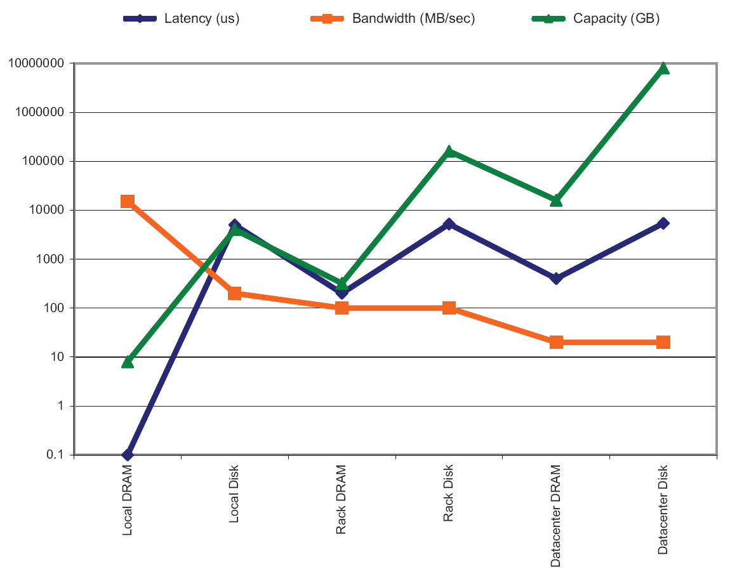
Storage Hierarchy
Source: Barroso and Urs Hölzle (2009)

Slide 17
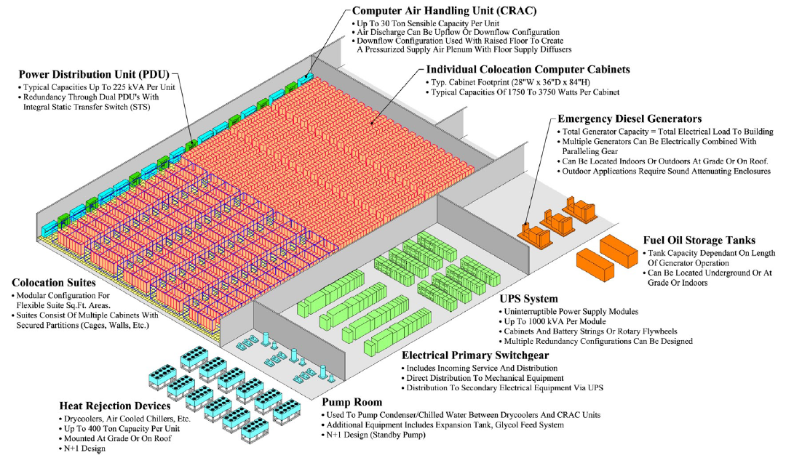
Anatomy of a Datacenter
Source: Barroso and Urs Hölzle (2009)

Slide 18
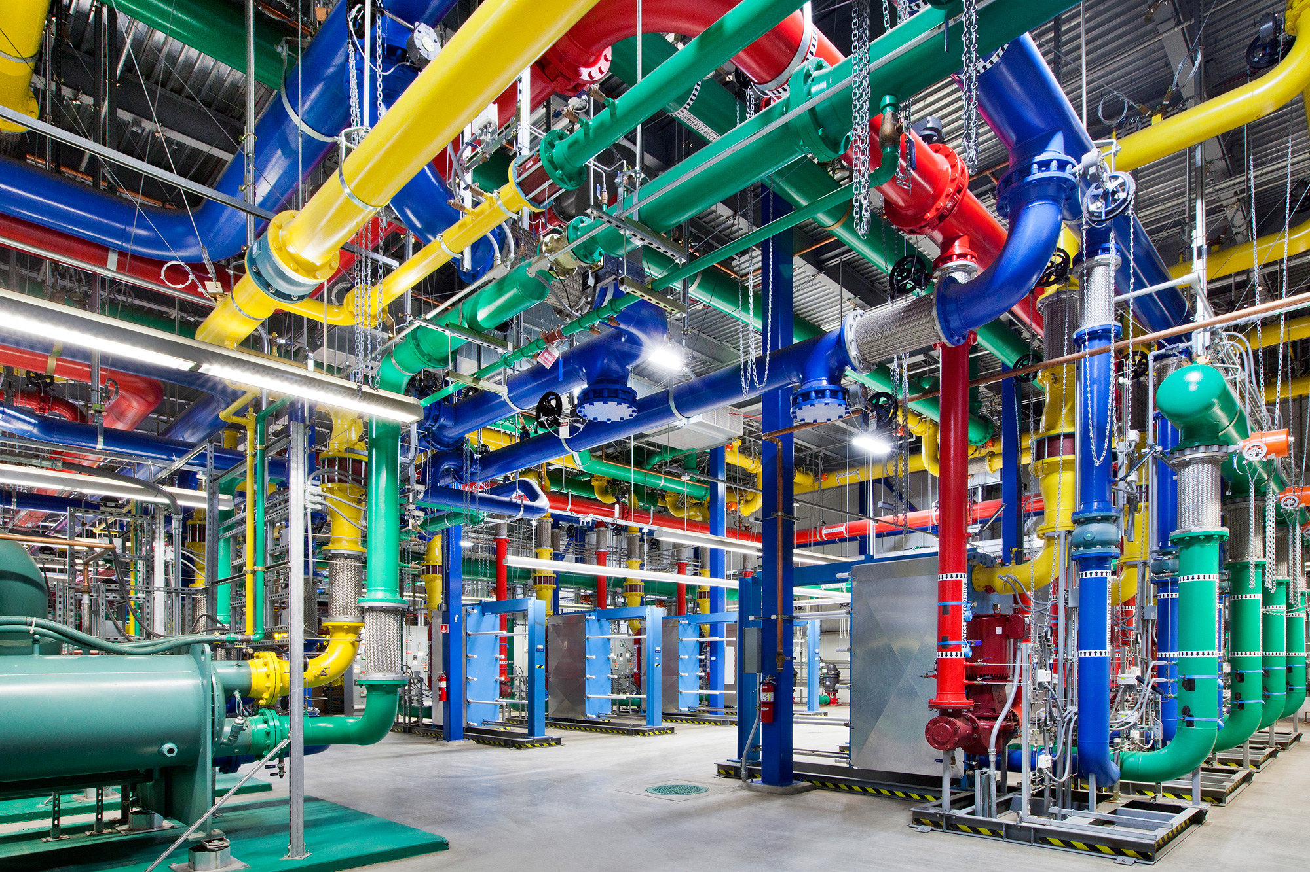
Source: Google

Slide 19
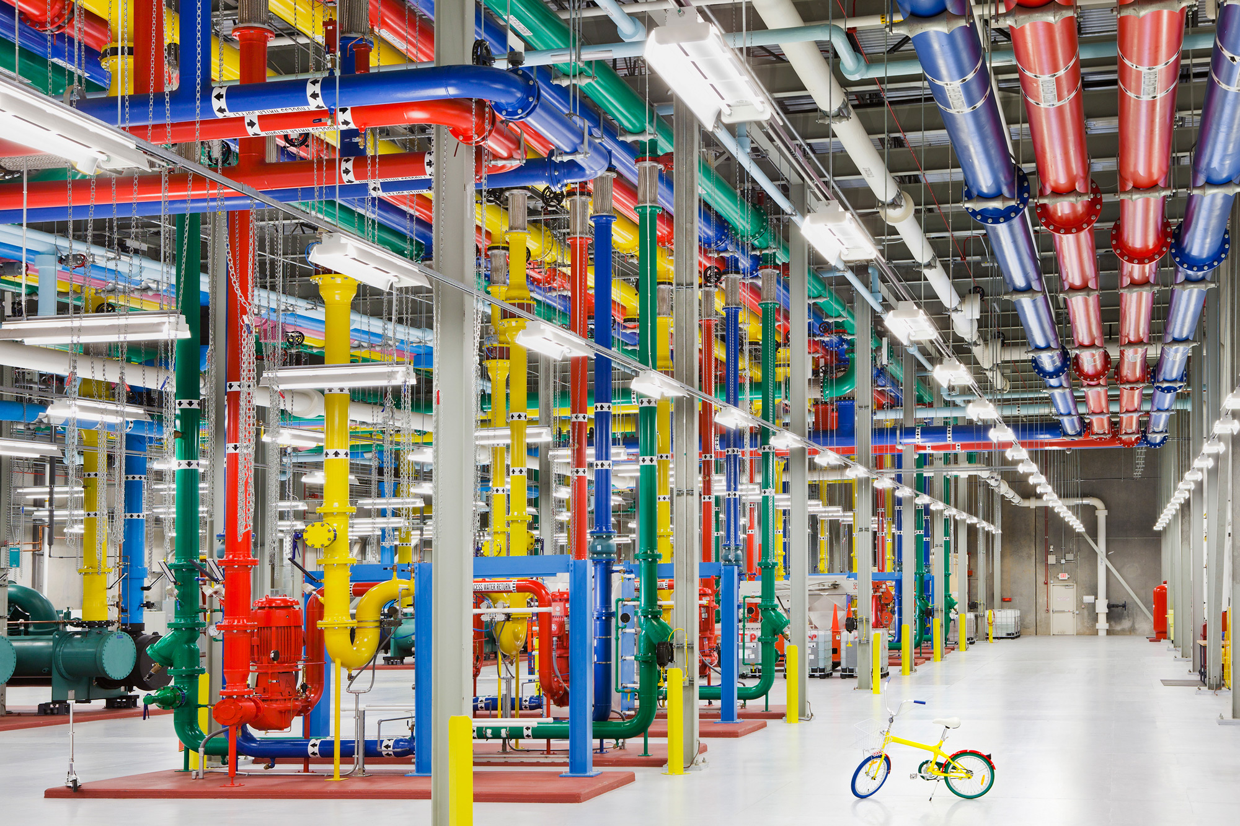
Source: Google

Slide 20
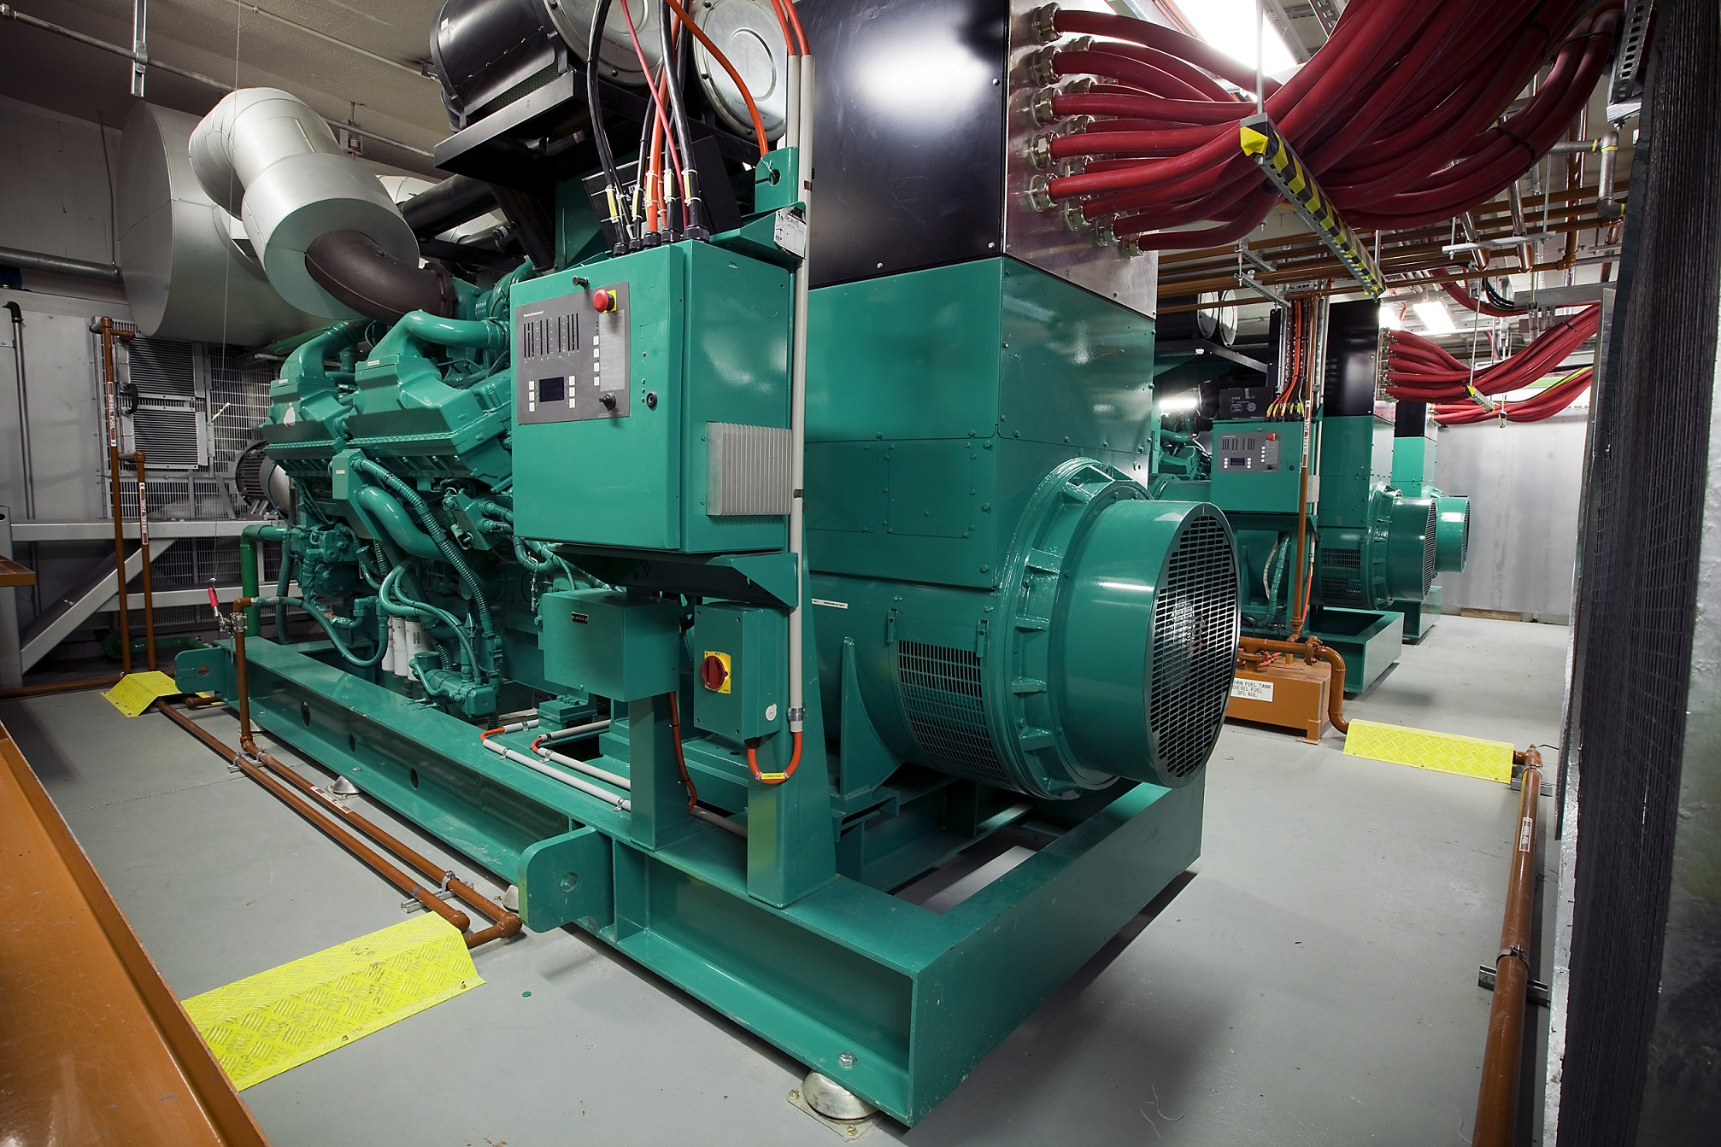
Source: CumminsPower

Slide 21
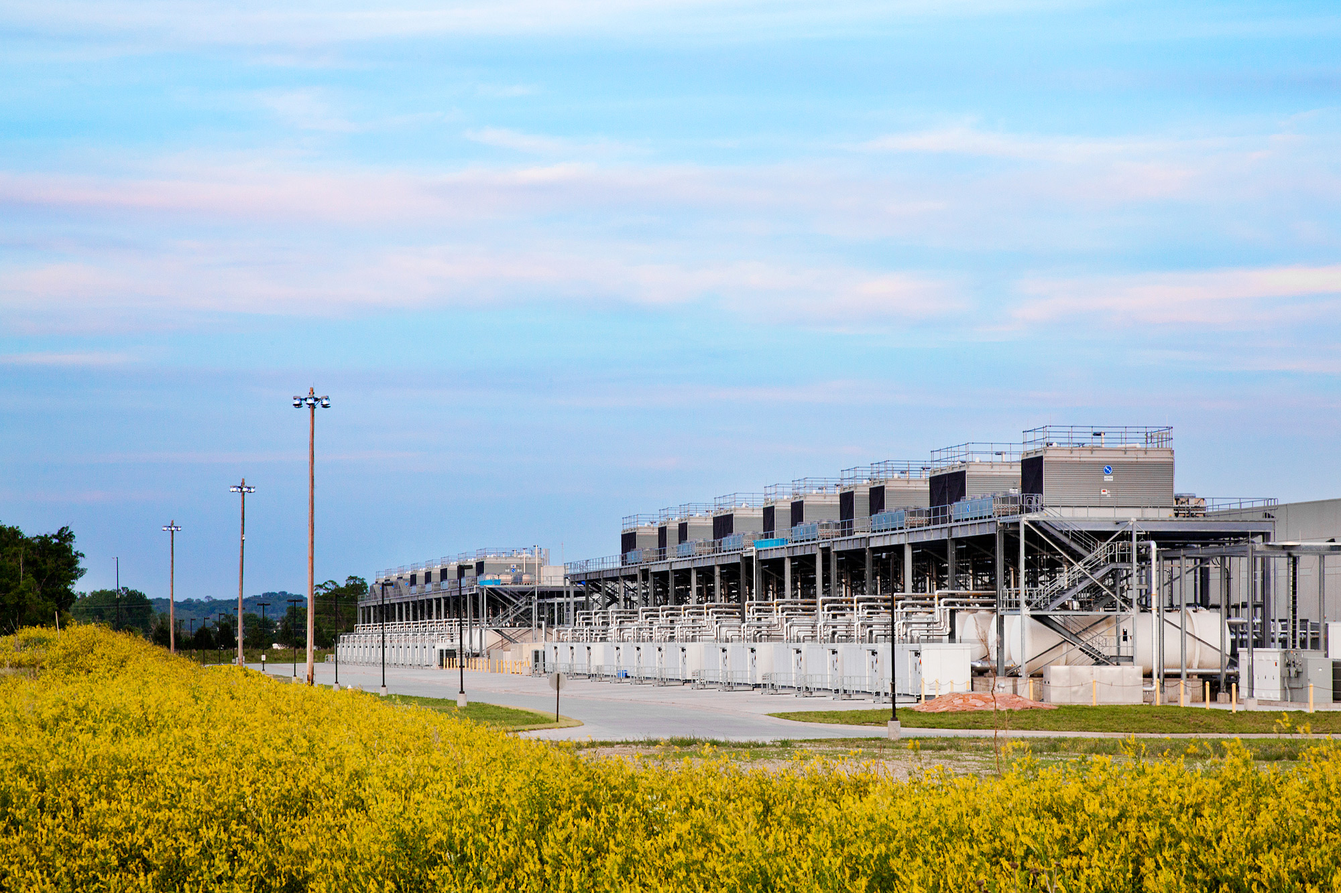
Source: Google

Slide 22
Aside: How much is 30 MW?
Source: Google

Slide 23
Scaling “up” vs. “out”
No single machine is large enough
Smaller cluster of large SMP machines vs. larger cluster of commodity machines (e.g., 8 128-core machines vs. 128 8-core machines)
Nodes need to talk to each other!
Intra-node latencies: ~100 ns
Inter-node latencies: ~100 μs
Let’s model communication overhead…
Source: analysis on this an subsequent slides from Barroso and Urs Hölzle (2009)

Slide 24
Modeling Communication Costs
Simple execution cost model:
Total cost = cost of computation + cost to access global data
Fraction of local access inversely proportional to size of cluster
n nodes (ignore cores for now)
Light communication: f =1
Medium communication: f =10
Heavy communication: f =100
What are the costs in parallelization?
1 ms + f × [100 ns × (1/n) + 100 μs × (1 - 1/n)]

Slide 25
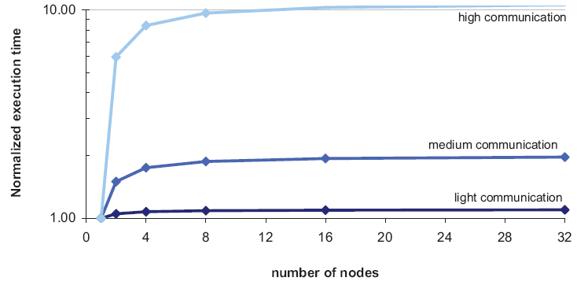
Cost of Parallelization

Slide 26
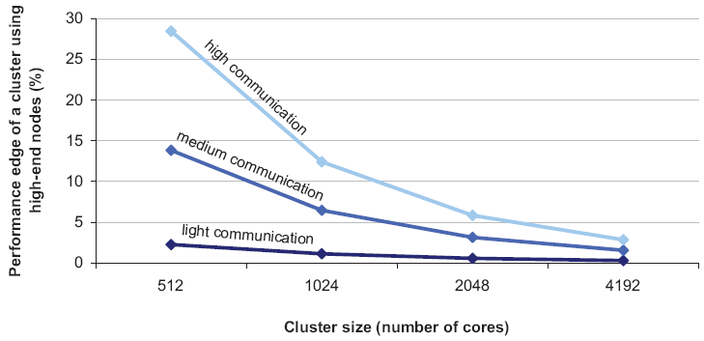
Advantages of scaling “up”
So why not?

Slide 27
Seeks vs. Scans
Consider a 1 TB database with 100 byte records
We want to update 1 percent of the records
Scenario 1: random access
Each update takes ~30 ms (seek, read, write)
10⁸ updates = ~35 days
Scenario 2: rewrite all records
Assume 100 MB/s throughput
Time = 5.6 hours(!)
Lesson: avoid random seeks!
Source: Ted Dunning, on Hadoop mailing list

Slide 28
Justifying the “Big Ideas”
Scale “out”, not “up”
Limits of SMP and large shared-memory machines
Move processing to the data
Cluster have limited bandwidth
Process data sequentially, avoid random access
Seeks are expensive, disk throughput is reasonable
Seamless scalability
From the mythical man-month to the tradable machine-hour

Slide 29
Numbers Everyone Should Know*
L1 cache reference | 0.5 ns
Branch mispredict | 5 ns
L2 cache reference | 7 ns
Mutex lock/unlock | 25 ns
Main memory reference | 100 ns
Send 2K bytes over 1 Gbps network | 20,000 ns
Read 1 MB sequentially from memory | 250,000 ns
Round trip within same datacenter | 500,000 ns
Disk seek | 10,000,000 ns
Read 1 MB sequentially from disk | 20,000,000 ns
Send packet CA → Netherlands → CA | 150,000,000 ns
* According to Jeff Dean (LADIS 2009 keynote)

Slide 30

Sequoia
16.32 PFLOPS
98,304 nodes with 1,572,864 million cores 1.6 petabytes of memory
7.9 MWatts total power

Slide 31
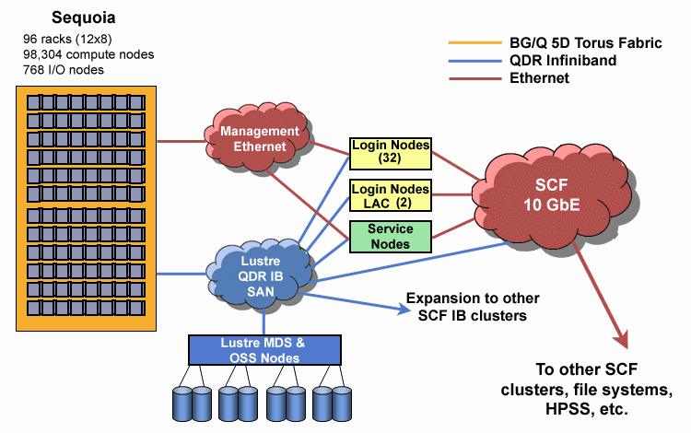
Source: LLNL

Slide 32
MapReduce
Source: Google

Slide 33
MapReduce: Recap
Programmers must specify:
map (k, v) → <k’, v’>*
reduce (k’, v’) → <k’, v’>*
All values with the same key are reduced together
Optionally, also:
partition (k’, number of partitions) → partition for k’
Often a simple hash of the key, e.g., hash(k’) mod n
Divides up key space for parallel reduce operations
combine (k’, v’) → <k’, v’>*
Mini-reducers that run in memory after the map phase
Used as an optimization to reduce network traffic
The execution framework handles everything else…

Slide 34
k₁
v₁
k₂
v₂
k₃
v₃
k₄
v₄
k₅
v₅
k₆
v₆
map
map
map
map
a
1
b
2
c
3
c
6
a
5
c
2
b
7
c
8
combine
combine
combine
combine
a
1
b
2
c
9
a
5
c
2
b
7
c
8
partition
partition
partition
partition
Shuffle and Sort: aggregate values by keys
a
1
5
b
2
7
c
2
9
8
reduce
reduce
reduce
r₁
s₁
r₂
s₂
r₃
s₃

Slide 35
“Everything Else”
The execution framework handles everything else…
Scheduling: assigns workers to map and reduce tasks
“Data distribution”: moves processes to data
Synchronization: gathers, sorts, and shuffles intermediate data
Errors and faults: detects worker failures and restarts
Limited control over data and execution flow
All algorithms must expressed in m, r, c, p
You don’t know:
Where mappers and reducers run
When a mapper or reducer begins or finishes
Which input a particular mapper is processing
Which intermediate key a particular reducer is processing

Slide 36
Tools for Synchronization
Cleverly-constructed data structures
Bring partial results together
Sort order of intermediate keys
Control order in which reducers process keys
Partitioner
Control which reducer processes which keys
Preserving state in mappers and reducers
Capture dependencies across multiple keys and values

Slide 37
Preserving State
Mapper object
Reducer object
one object per task
state
state
setup
API initialization hook
setup
map
one call per input key-value pair
reduce
one call per intermediate key
cleanup
API cleanup hook
close

Slide 38
Scalable Hadoop Algorithms: Themes
Avoid object creation
Inherently costly operation
Garbage collection
Avoid buffering
Limited heap size
Works for small datasets, but won’t scale!

Slide 39
Importance of Local Aggregation
Ideal scaling characteristics:
Twice the data, twice the running time
Twice the resources, half the running time
Why can’t we achieve this?
Synchronization requires communication
Communication kills performance
Thus… avoid communication!
Reduce intermediate data via local aggregation
Combiners can help

Slide 40
Shuffle and Sort
Mapper
intermediate files (on disk)
merged spills (on disk)
Combiner
Reducer
circular buffer (in memory)
Combiner
other reducers
spills (on disk)
other mappers

Slide 41
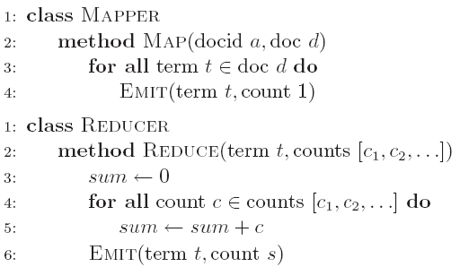
Word Count: Baseline
What’s the impact of combiners?

Slide 42
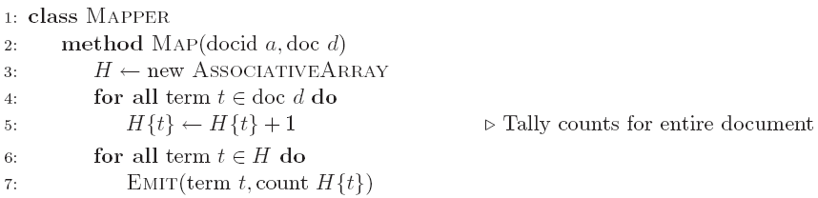
Word Count: Version 1
Are combiners still needed?

Slide 43
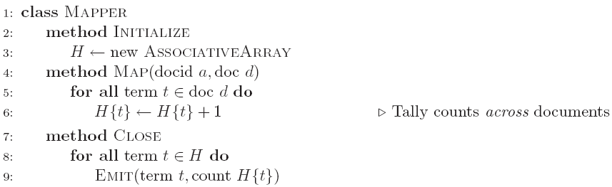
Word Count: Version 2
Key idea: preserve state across input key-value pairs!
Are combiners still needed?

Slide 44
Design Pattern for Local Aggregation
“In-mapper combining”
Fold the functionality of the combiner into the mapper by preserving state across multiple map calls
Advantages
Speed
Why is this faster than actual combiners?
Disadvantages
Explicit memory management required
Potential for order-dependent bugs

Slide 45
Combiner Design
Combiners and reducers share same method signature
Sometimes, reducers can serve as combiners
Often, not…
Remember: combiner are optional optimizations
Should not affect algorithm correctness
May be run 0, 1, or multiple times
Example: find average of integers associated with the same key

Slide 46
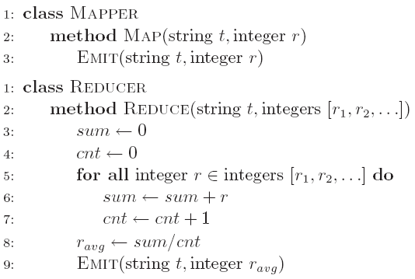
Computing the Mean: Version 1
Why can’t we use reducer as combiner?

Slide 47
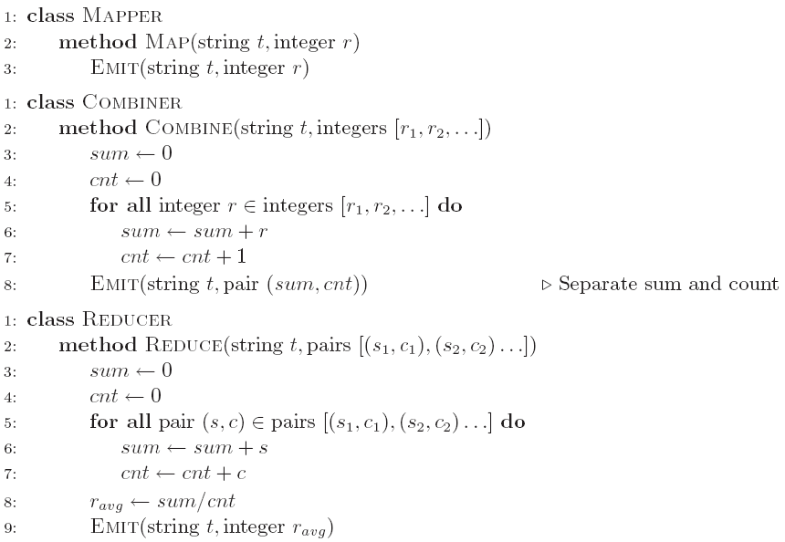
Computing the Mean: Version 2
Why doesn’t this work?

Slide 48
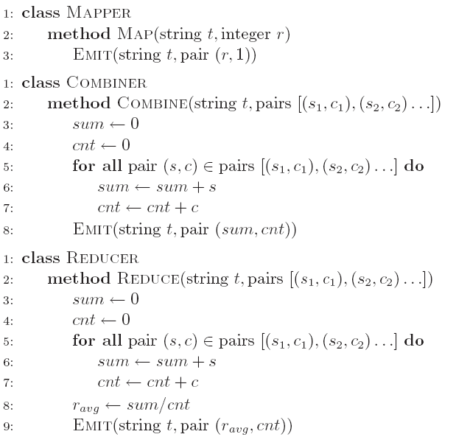
Computing the Mean: Version 3
Fixed?

Slide 49
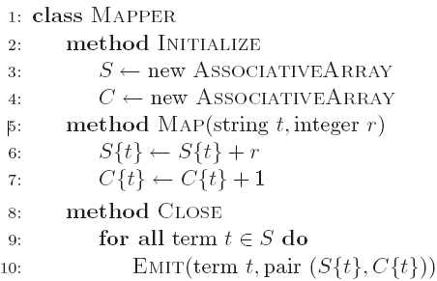
Computing the Mean: Version 4
Are combiners still needed?

Slide 50
Algorithm Design: Running Example
Term co-occurrence matrix for a text collection
M = N x N matrix (N = vocabulary size)
M_{ij}: number of times i and j co-occur in some context (for concreteness, let’s say context = sentence)
Why?
Distributional profiles as a way of measuring semantic distance
Semantic distance useful for many language processing tasks

Slide 51
MapReduce: Large Counting Problems
Term co-occurrence matrix for a text collection = specific instance of a large counting problem
A large event space (number of terms)
A large number of observations (the collection itself)
Goal: keep track of interesting statistics about the events
Basic approach
Mappers generate partial counts
Reducers aggregate partial counts
How do we aggregate partial counts efficiently?

Slide 52
First Try: “Pairs”
Each mapper takes a sentence:
Generate all co-occurring term pairs
For all pairs, emit (a, b) → count
Reducers sum up counts associated with these pairs
Use combiners!

Slide 53
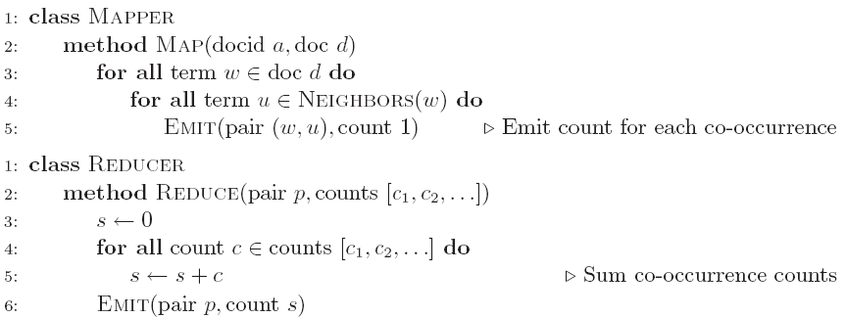
Pairs: Pseudo-Code

Slide 54
“Pairs” Analysis
Advantages
Easy to implement, easy to understand
Disadvantages
Lots of pairs to sort and shuffle around (upper bound?)
Not many opportunities for combiners to work

Slide 55
Another Try: “Stripes”
Idea: group together pairs into an associative array
Each mapper takes a sentence:
Generate all co-occurring term pairs
For each term, emit a → { b: count_{b}, c: count_{c}, d: count_{d} … }
Reducers perform element-wise sum of associative arrays
(a, b) → 1
(a, c) → 2
(a, d) → 5
(a, e) → 3
(a, f) → 2
a → { b: 1, c: 2, d: 5, e: 3, f: 2 }
a → { b: 1, d: 5, e: 3 }
a → { b: 1, c: 2, d: 2, f: 2 }
a → { b: 2, c: 2, d: 7, e: 3, f: 2 }
+
Key idea: cleverly-constructed data structure
brings together partial results

Slide 56
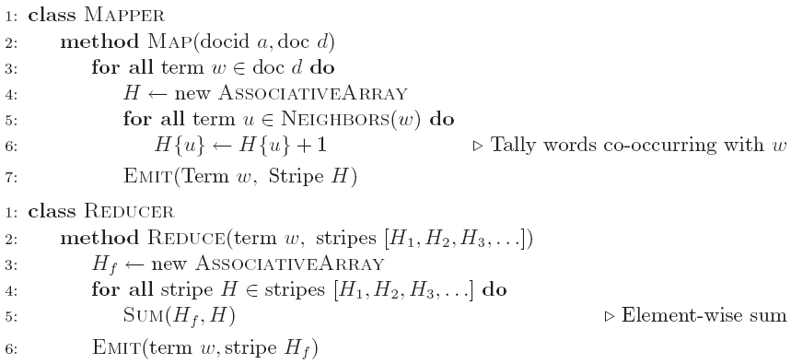
Stripes: Pseudo-Code

Slide 57
“Stripes” Analysis
Advantages
Far less sorting and shuffling of key-value pairs
Can make better use of combiners
Disadvantages
More difficult to implement
Underlying object more heavyweight
Fundamental limitation in terms of size of event space

Slide 58
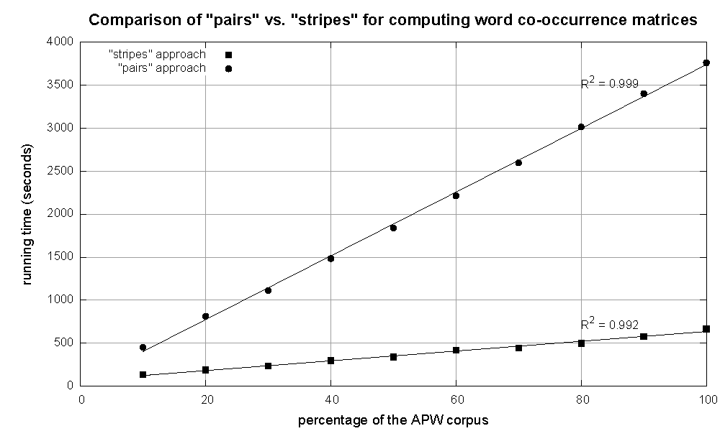
Cluster size: 38 cores
Data Source: Associated Press Worldstream (APW) of the English Gigaword Corpus (v3), which contains 2.27 million documents (1.8 GB compressed, 5.7 GB uncompressed)

Slide 59
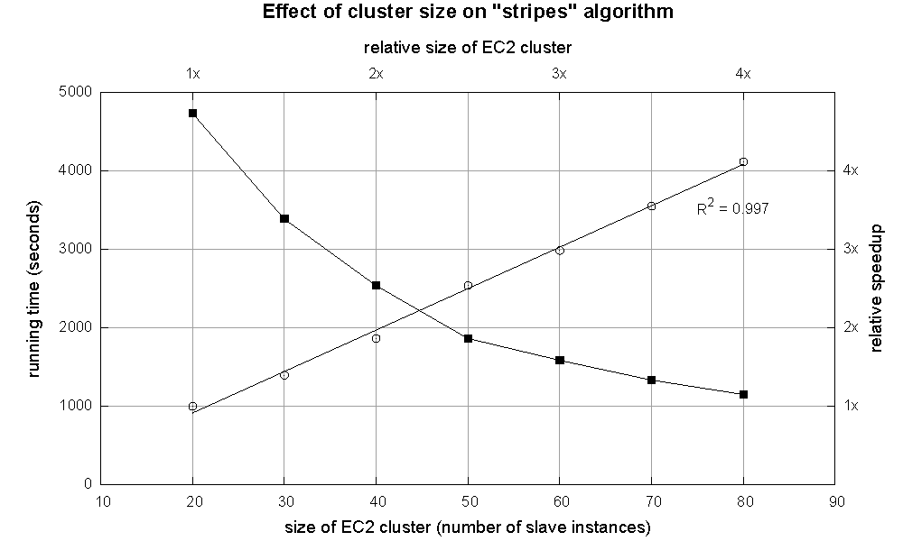

Slide 60
Relative Frequencies
How do we estimate relative frequencies from counts?
Why do we want to do this?
How do we do this with MapReduce?

Slide 61
f(B|A): “Stripes”
Easy!
One pass to compute (a, *)
Another pass to directly compute f(B|A)
a → {b₁:3, b₂ :12, b₃ :7, b₄ :1, … }

Slide 62
f(B|A): “Pairs”
What’s the issue?
Computing relative frequencies requires marginal counts
But the marginal cannot be computed until you see all counts
Buffering is a bad idea!
Solution:
What if we could get the marginal count to arrive at the reducer first?

Slide 63
f(B|A): “Pairs”
For this to work:
Must emit extra (a, *) for every b_{n} in mapper
Must make sure all a’s get sent to same reducer (use partitioner)
Must make sure (a, *) comes first (define sort order)
Must hold state in reducer across different key-value pairs
(a, *) → 32
Reducer holds this value in memory
(a, b₁) → 3
(a, b₂) → 12
(a, b₃) → 7
(a, b₄) → 1
…
(a, b₁) → 3 / 32
(a, b₂) → 12 / 32
(a, b₃) → 7 / 32
(a, b₄) → 1 / 32
…

Slide 64
“Order Inversion”
Common design pattern:
Take advantage of sorted key order at reducer to sequence computations
Get the marginal counts to arrive at the reducer before the joint counts
Optimization:
Apply in-memory combining pattern to accumulate marginal counts

Slide 65
Synchronization: Pairs vs. Stripes
Approach 1: turn synchronization into an ordering problem
Sort keys into correct order of computation
Partition key space so that each reducer gets the appropriate set of partial results
Hold state in reducer across multiple key-value pairs to perform computation
Illustrated by the “pairs” approach
Approach 2: construct data structures that bring partial results together
Each reducer receives all the data it needs to complete the computation
Illustrated by the “stripes” approach

Slide 66
Secondary Sorting
MapReduce sorts input to reducers by key
Values may be arbitrarily ordered
What if want to sort value also?
E.g., k → (v₁, r), (v₃, r), (v₄, r), (v₈, r)…

Slide 67
Secondary Sorting: Solutions
Solution 1:
Buffer values in memory, then sort
Why is this a bad idea?
Solution 2:
“Value-to-key conversion” design pattern: form composite intermediate key, (k, v₁)
Let execution framework do the sorting
Preserve state across multiple key-value pairs to handle processing
Anything else we need to do?

Slide 68
Recap: Tools for Synchronization
Cleverly-constructed data structures
Bring data together
Sort order of intermediate keys
Control order in which reducers process keys
Partitioner
Control which reducer processes which keys
Preserving state in mappers and reducers
Capture dependencies across multiple keys and values

Slide 69
Issues and Tradeoffs
Number of key-value pairs
Object creation overhead
Time for sorting and shuffling pairs across the network
Size of each key-value pair
De/serialization overhead
Local aggregation
Opportunities to perform local aggregation varies
Combiners make a big difference
Combiners vs. in-mapper combining
RAM vs. disk vs. network

Slide 70
Debugging at Scale
Works on small datasets, won’t scale… why?
Memory management issues (buffering and object creation)
Too much intermediate data
Mangled input records
Real-world data is messy!
There’s no such thing as “consistent data”
Watch out for corner cases
Isolate unexpected behavior, bring local

Slide 71
Questions?
Source: Wikipedia (Japanese rock garden)

